Slide 1

Gospel Chance 2026
DAY 1 (09:00–11:00)
ORIENTATION & FOUNDATIONS
Welcome to Gospel Chance 2026
27th July, 2026

Slide 2
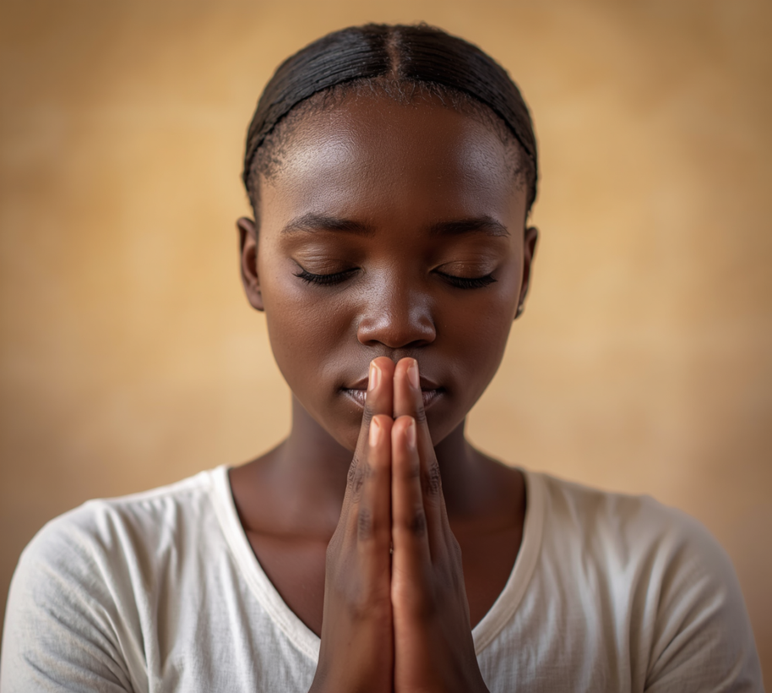
Devotion Time:
Jesus Came
— Day 1
“This is a faithful saying and worthy of all acceptance, that Christ Jesus came into the world to save sinners, of whom I an chief."
1 Timothy 1:15

Slide 3
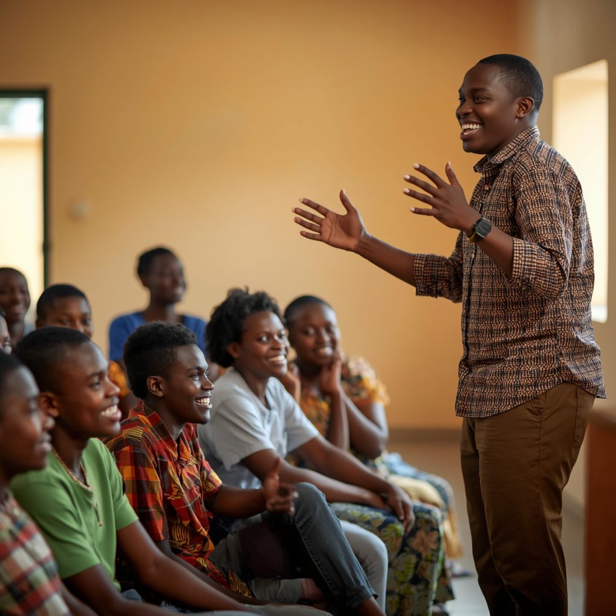
Welcome & Orientation

Slide 4



E-Chance International LBG
History & Gospel Chance
Vision, Mission & Objectives, Programmes
Founders & Board Members

Slide 5


🏆 Gold Medal RiSE 2024
🌟 Bronze Medal 2024 African Youth in AI and Robotics Competition
Awards
Experience It! Express It.
Partnership with OCC 2025, 2026 seasons.
Gospel Chance
Recognition & Impact

Slide 6

Introductions
Tell us your name, hometown, and favourite hobby — let's get to know each other!

Slide 7




The Final Authority
  God's Message
God commanded the disciples to preach the Gospel to every creature (Mark 16:15).
God’s love extends to every individual in the world (John 3:16a).
The promise of salvation was not given with age limits.
John 3:16….whosoever believeth….
John 1:12….as many as received Him….
Romans 10:13….whosoever shall call…..
(CEF, 2016)

Slide 8
The Final Authority
  2. Who is Lost?
Teenagers have a sinful nature.
Romans 3:23 – “For all have sinned, and come short of the glory of God.”
Romans 5:12 – “Wherefore, as by one man sin entered into the world, and death by sin; and so death passed upon all men, for that all have sinned.”
Psalm 51:5 – “Behold, I was shapen in iniquity; and in sin did my mother conceive me.”
Teenagers need to be made aware of their condition before God.
The Bible commands us to evangelize EVERYBOBY (Mark 16:15). This means we are required to evangelize all teenagers in a thorough, biblical way, and live the question of regeneration in the hands of God.
(CEF, 2016)

Slide 9




WORSHIP TIME

Slide 10

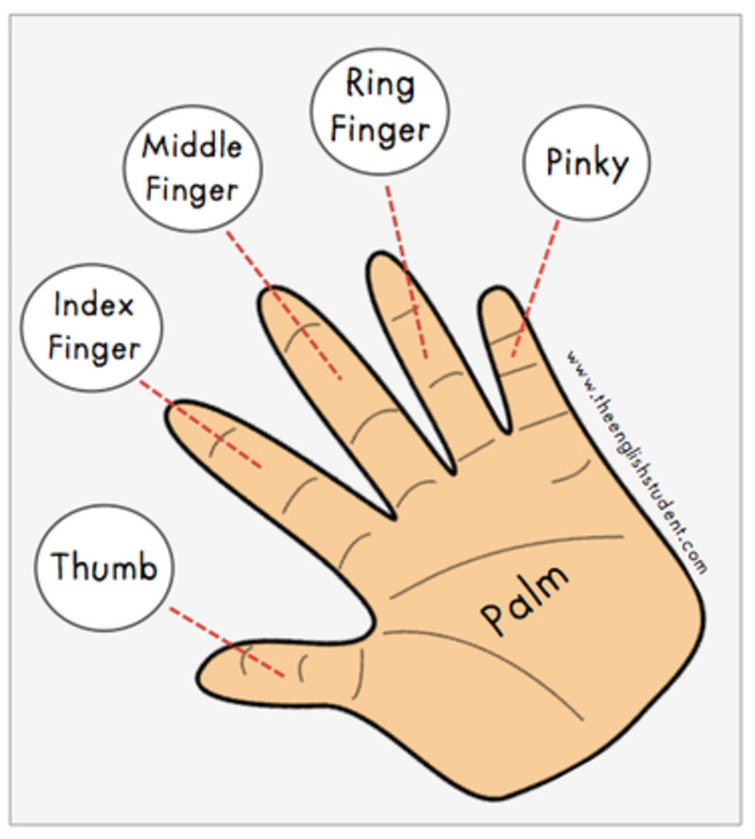
Who God Is:
God is the Creator
Heaven is God’s home
God loves YOU (John3:16a)
God is Holy
My Body the Temple
The Teenager's Desire
Missionary Story.
Can the Hand & Fingers Preach the Gospel?

Slide 11
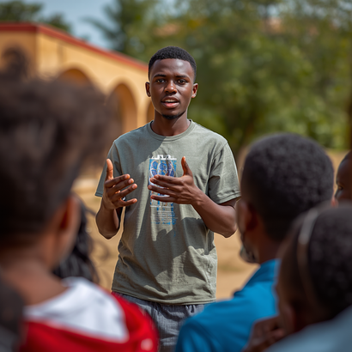


Practice Activity
Sharing the Gospel with Confidence
Gospel Outline
2-Minute Explanation
Tips for Sharing
I want to tell you the most amazing story ever. My thumb reminds me of God:
God is the Creator
Heaven is God’s home
God loves YOU (John3:16a)
God is Holy meaning He is without sin.
Link: Your sin separates you from God
Pair up with a partner and take turns sharing the Gospel in 2 minutes. One person shares while the other listens, then switch.
Speak clearly and with confidence. Use simple language your audience understands. Make eye contact, smile, and let your faith shine through. Practice makes the message powerful!

Slide 12


Key Takeaways:
GOD'S WORD IS FINAL
Go and apply what you've learned!
YOUR BODY IS THE TEMPLE OF GOD
SHARE THE GOSPEL
Day 1 — 27th July, 2026 | See you tomorrow!

